Slide 1
Topic Review
Quiz

Slide 2
Name the picture

Slide 3
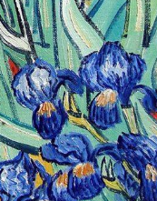
1

Slide 4
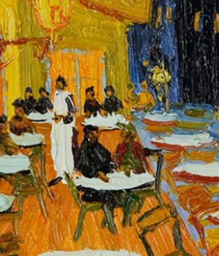
2

Slide 5
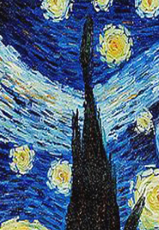
3

Slide 6
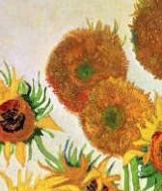
4

Slide 7
Famous Five

Slide 8
5
What are the children called?

Slide 9
6
Where did they go on holiday?

Slide 10
7
What is an ingot?

Slide 11
8
Where were the children trapped?

Slide 12
9
Who is the non-human member of the Famous Five?

Slide 13
Van Gogh

Slide 14
10
Where was Van Gogh born?

Slide 15
11
What languages could Van Gogh speak?

Slide 16
12
What was the name of his favourite brother?

Slide 17
13
How much did his painting, Sunflowers, sell for?

Slide 18
14
Where would you have to visit to see Irises?

Slide 19
Katie and the sunflowers

Slide 20
15
Who did Katie visit the art gallery with?

Slide 21
16
Name one painting Katie went inside.

Slide 22
17
Who helped Katie tidy up the sunflowers?

Slide 23
Answers

Slide 24
Name the picture

Slide 25
Iris

Slide 26
Café Terrace at Night

Slide 27
Starry Night

Slide 28
Sunflowers

Slide 29
Famous Five

Slide 30
What are the children called?
Dick, Ann, Julian and George

Slide 31
Where did they go on holiday?
Kirrin

Slide 32
What is an ingot?
bar of gold (precious metal)

Slide 33
Where were the children trapped?
in a dungeon

Slide 34
Who is the non-human member of the Famous Five?
Timmy the dog

Slide 35
Van Gogh

Slide 36
Where was Van Gogh born?
The Netherlands

Slide 37
What languages could Van Gogh speak?
Dutch, French and English

Slide 38
What was the name of his favourite brother?
Theo

Slide 39
How much did his painting, Sunflowers, sell for?
40 Million

Slide 40
Where would you have to visit to see Irises?
Los Angeles, USA

Slide 41
Katie and the sunflowers

Slide 42
Who did Katie visit the art gallery with?
Grandma

Slide 43
Name one painting Katie went inside.
Sunflowers
Breton Girls Dancing
Café Terrace at Night
Still Life
Tahitian Pastorals

Slide 44
Who helped Katie tidy up the sunflowers?
Mimi

Slide 45
Well done!

